Slide 1

TMNL- Spark, Graphs & ML
Notes:
<number>

Slide 2

About me
Usman Zafar

Slide 3
About you
Your name
What you do
What you hope to learn
Your Spark/Graphs/ML experience
What do you think of Spark?

Slide 4
Agenda
Technical setup
Graph basics
GraphFrames
Basic graph algorithms
Brainstorm use-cases
Simple exercises
Tackling an example use-case
Mini hackathon

Slide 5
Repository
https://xebia.ai/v6v

Slide 6
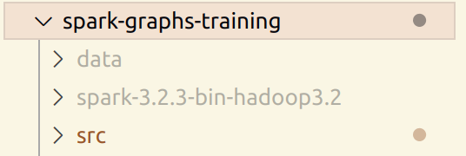
Installation
Copy your Spark release (spark-3.2.3-bin-hadoop3.2) into the directory with the project files
Inside the jars/ directory, you should have copied the graphframes-0.8.2-spark3.2-s_2.12.jar
Your directory should look like:

Slide 7
Installation
Open a terminal, and navigate to the base directory of the project.
Run the following command:
export SPARK_SUBMIT=./spark-3.2.3-bin-hadoop3.2/bin/spark-submit
Submit a job using the command:
$SPARK_SUBMIT src/script.py --argument1
Test set up with the command:
$SPARK_SUBMIT src/test_spark.py

Slide 8
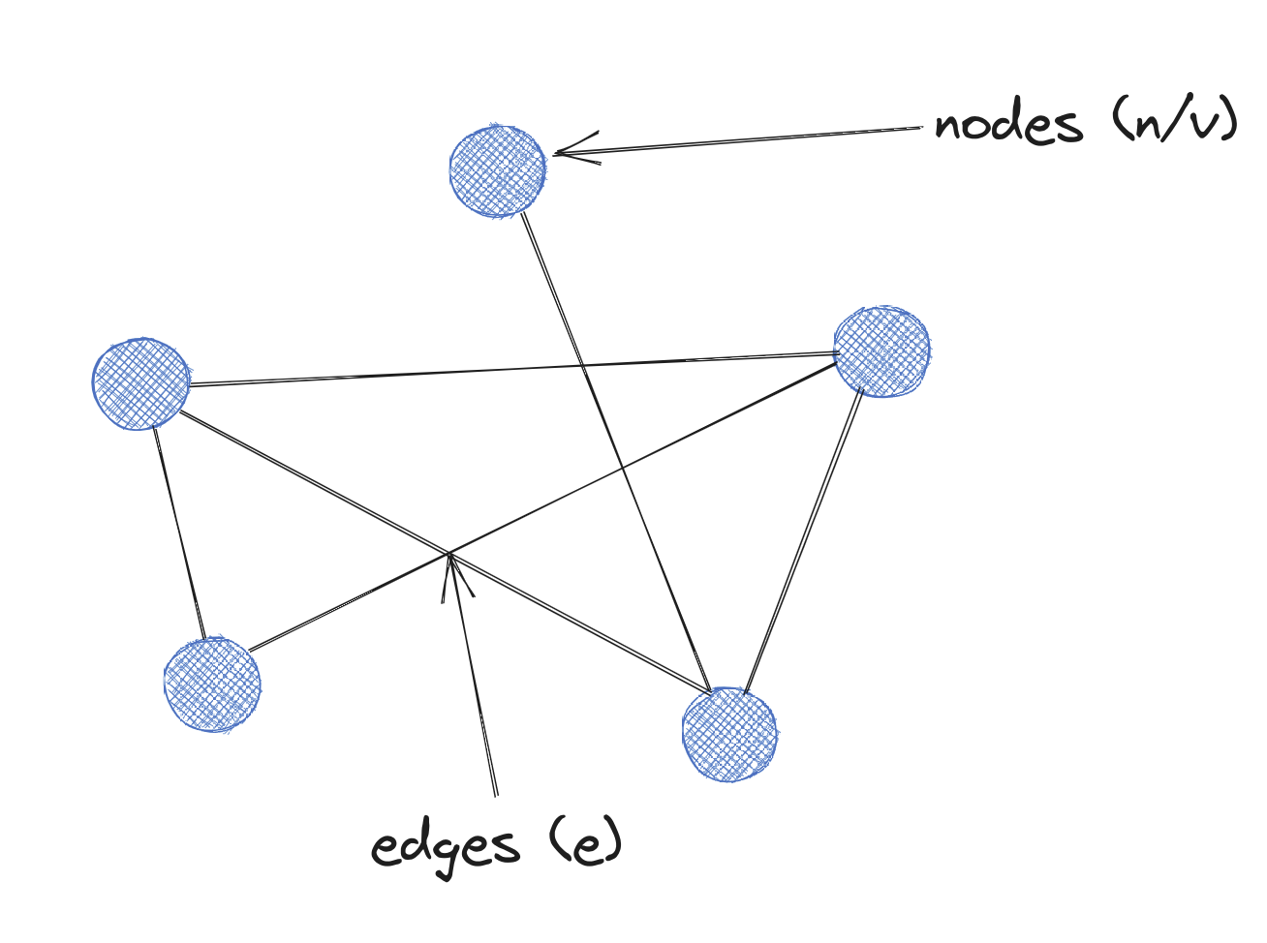
Graph basics

Slide 9
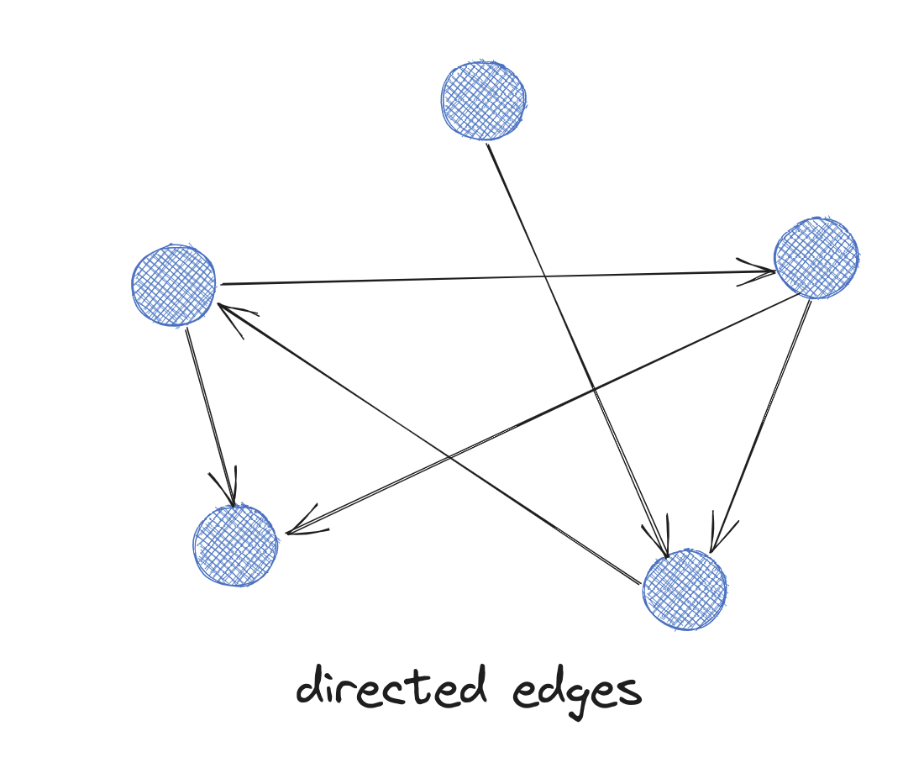
Graph basics

Slide 10
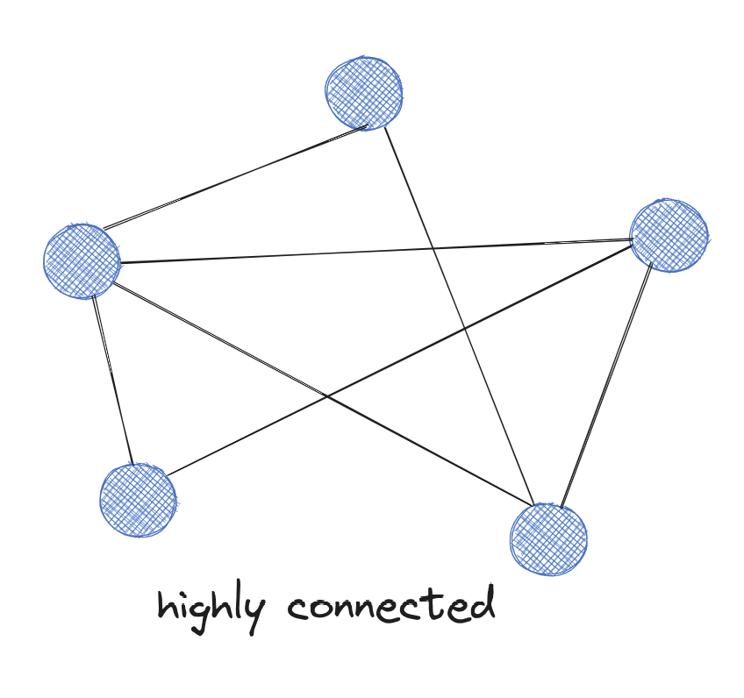
Graph basics

Slide 11
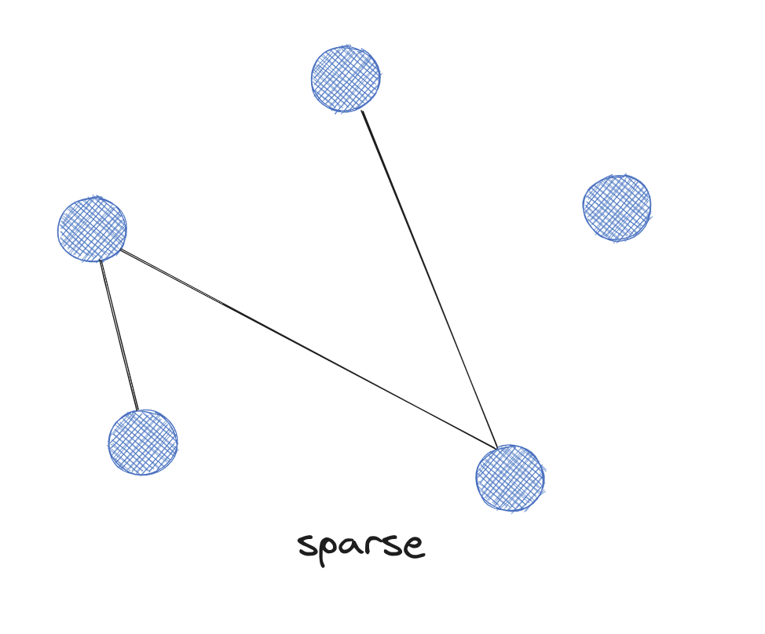
Graph basics

Slide 12
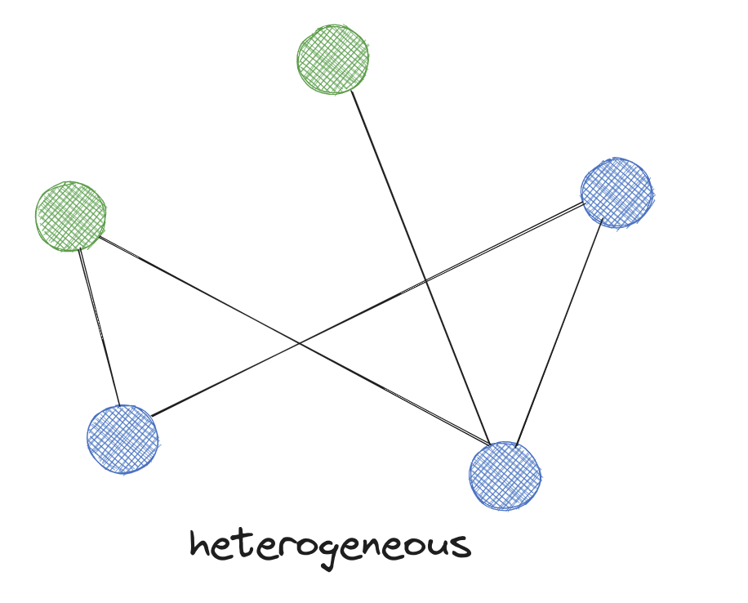
Graph basics

Slide 13
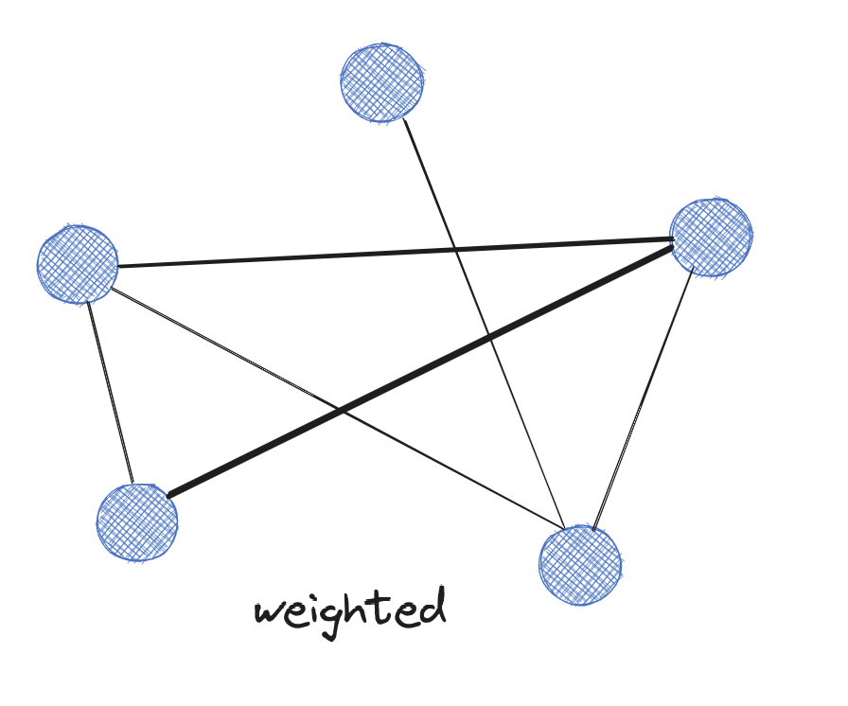
Graph basics

Slide 14
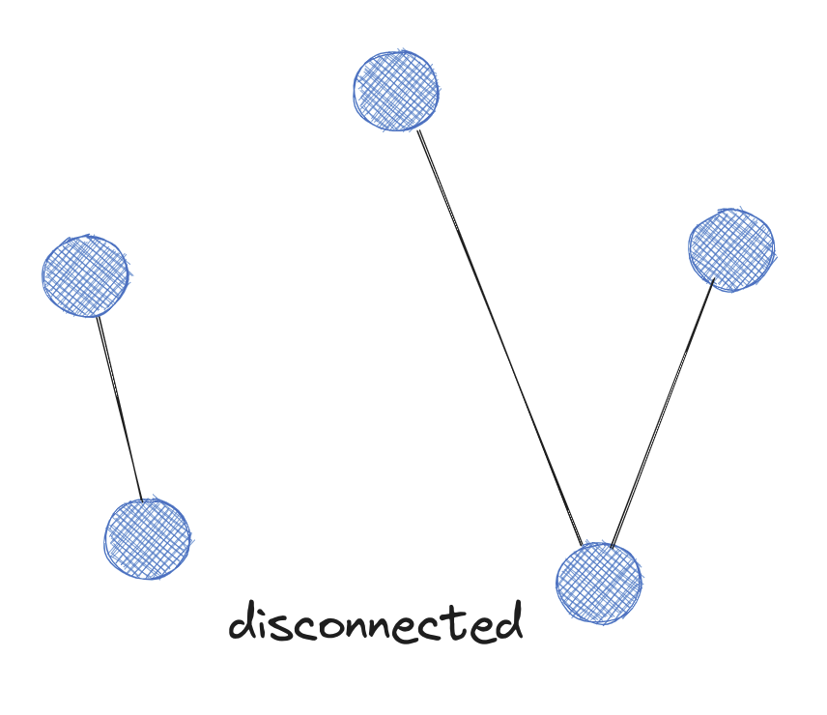
Graph basics

Slide 15
Processing considerations
Node-centric – nodes are processing units
Relationship-centric – similar to above
Graph-centric – nodes within subgraph processed independently
Traversal-centric – these models use accumulation of data by traverser
Algorithm-centric – combination of above

Slide 16
Platform considerations
Graph compute engines – Spark, Giraph, GraphLab
Graph databases – Neo4j, Neptune, ArangoDB etc.

Slide 17
GraphFrames
“GraphFrames is a package for Apache Spark which provides DataFrame-based Graphs”
GraphX is built on top of RDDs, GraphFrames built on top of DataFrames

Slide 18
GraphFrames Basics
GraphFrame object created from two DataFrame objects: edges and vertices
Vertices: Must contain “id” column and optional additional columns describing each vertex
Edges: Must contain “src” and “dst” column and optional columns describing relationships i.e. “friend”, “follow”.

Slide 19
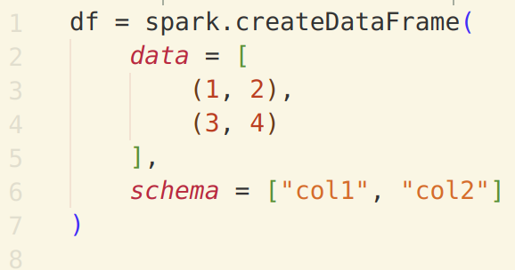
GraphFrames Basics
Reminder: creating a DataFrame:

Slide 20
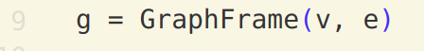
GraphFrames Basics
Reminder: creating a GraphFrame:

Slide 21
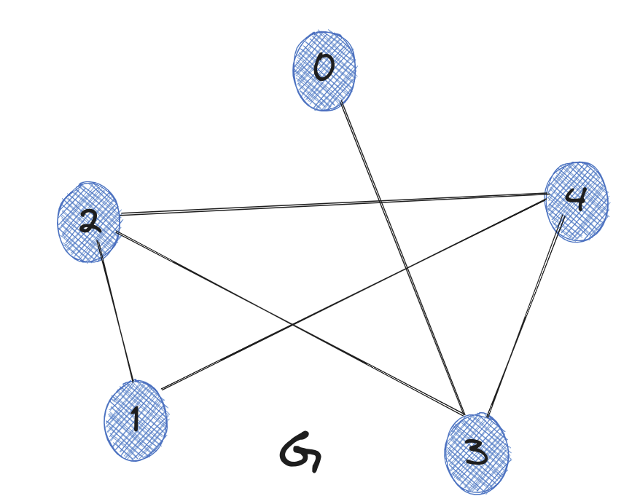
Exercise 1
Create a GraphFrame object representing the following graph (ignore bidirectional edges, so only i,j needed for all i,j where i<j):
Important
- Vertices DataFrame needs “id”
- Edges column needs “src” and “dst” (where “src” and “dst” correspond to the “id” column from the vertices DataFrame

Slide 22
Exercise 2
Using the graph created in the previous step, create a single DataFrame showing the total number of edges incident on each vertex (inwards and outwards).
(Tip: GraphFrame object has two attributes: inDegrees and outDegrees)

Slide 23
Exercise 3
(a) Consider we have a DataFrame with two columns “src” and “dst”. The egdes represent connections in only one direction i.e. src=x, dst=y but not src=y, dst=x for all x,y.
Create a DataFrame which adds in the edges representing the connections in the opposite direction.
The initial DataFrame is provided.

Slide 24
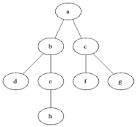
Breadth-first search (BFS)
Shortest path from one vertex to another (or a set of vertices)
Uses a queue (FIFO) and maintains a “visited” list

Slide 25
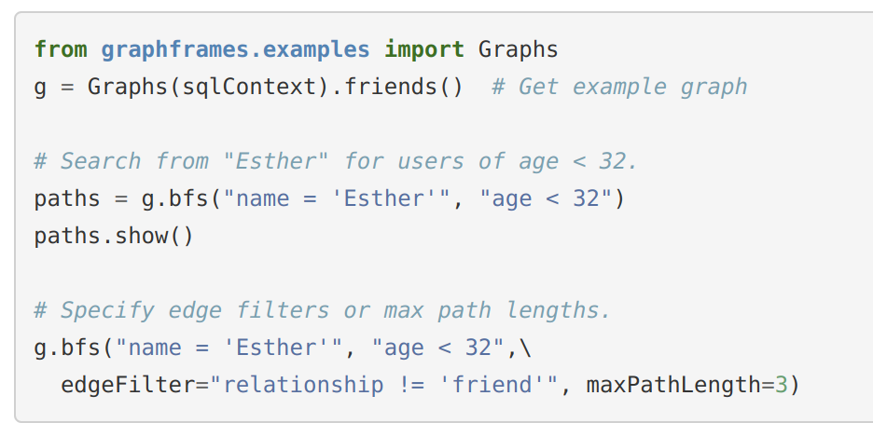
BFS Example

Slide 26
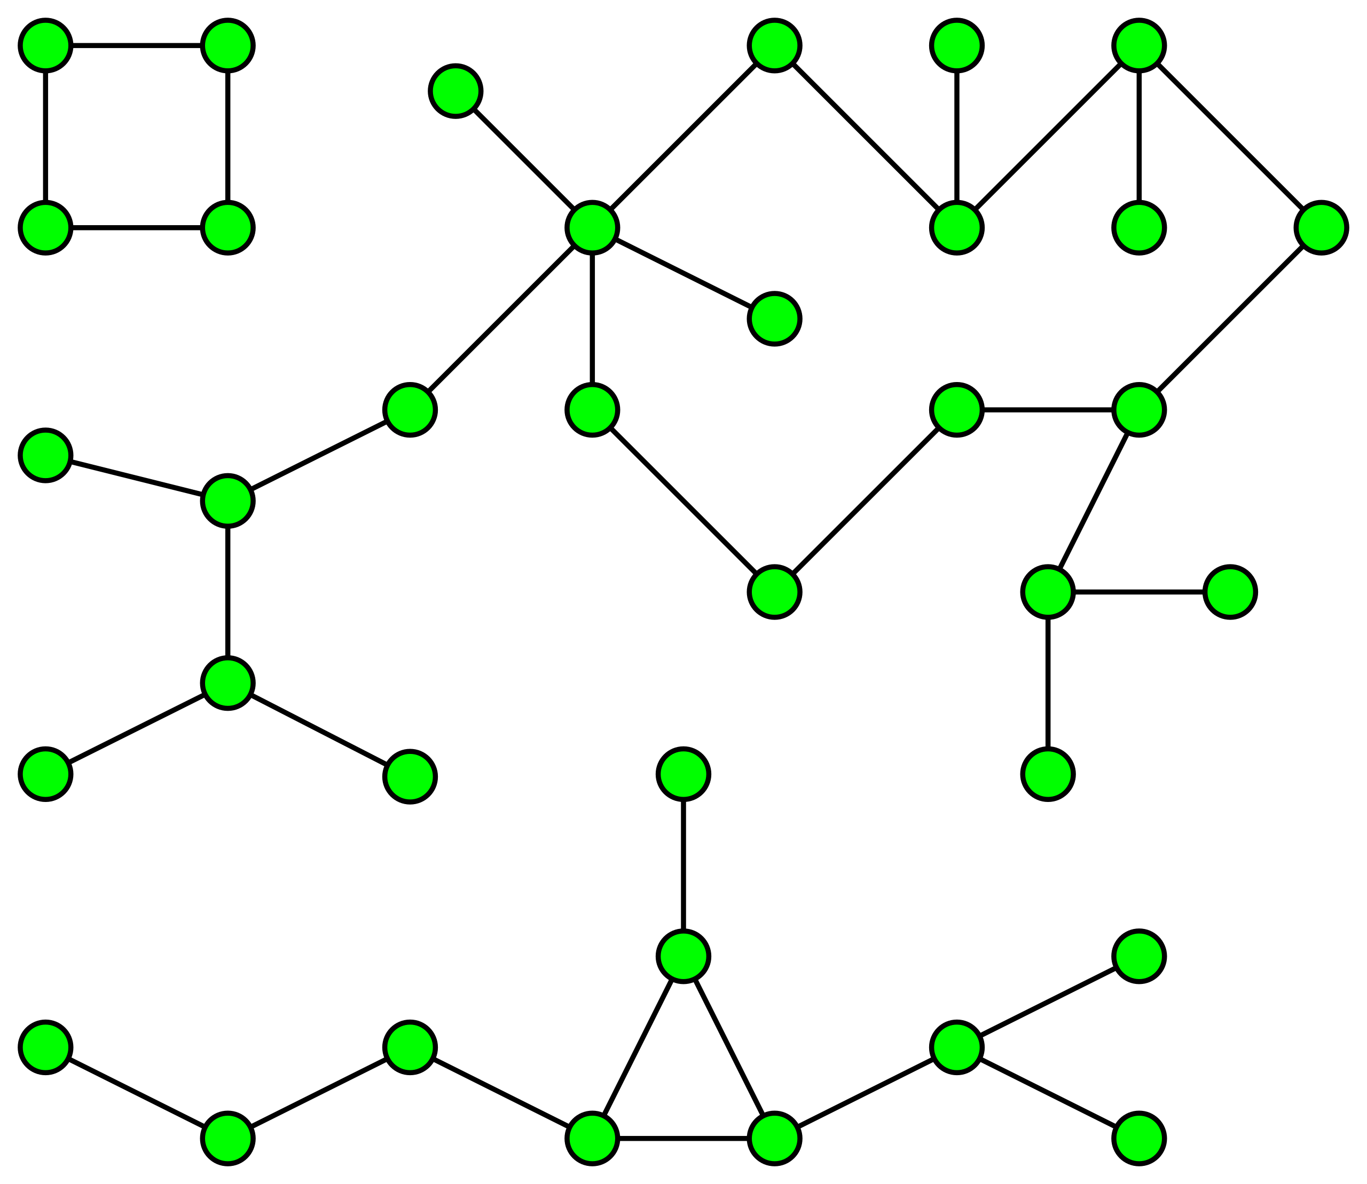
Connected Components
Calculates the connected component membership of each vertex and returns a graph with each vertex assigned a component ID

Slide 27
Strongly Connected Components
For directed graphs, a subgraph inside the wider graph is connected if every vertex is reachable from every other vertex
Can be used to solve 2-satisfiability problems (system of boolean variables with constraints on pairs of values)
Also used in mathematical modeling (specifically engineering-related modeling)
Useful for finding interesting patterns in how different subgraphs interact with each other

Slide 28
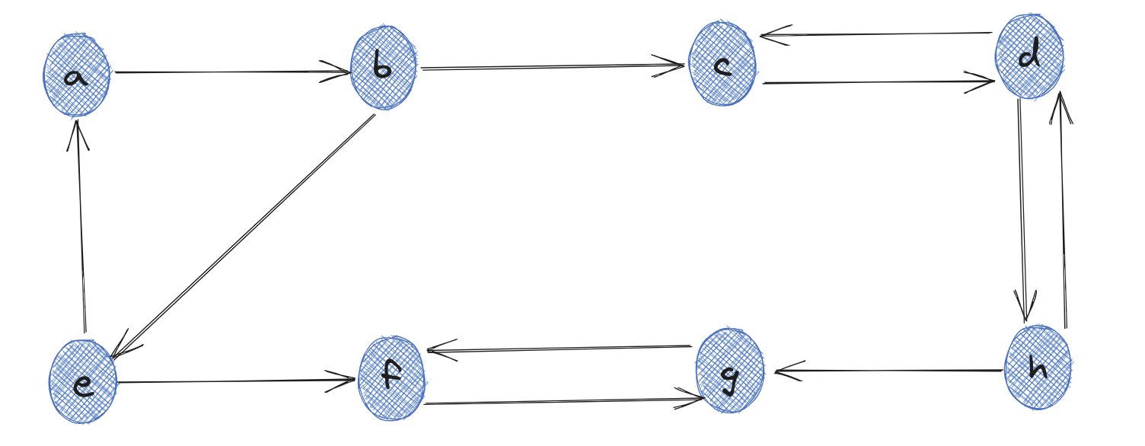
Strongly Connected Components

Slide 29
Label Propagation Algorithm (LPA)
Used to detect communities in networks
Each node in the network is initially assigned to its own community. At every superstep, nodes send their community affiliation to all neighbors and update their state to the mode community affiliation of incoming messages.
Convergence not guaranteed
Highly dependent on underlying graph as one can end up with trivial solutions (i.e. all nodes assigned to a single community)
The intuition behind the algorithm is that a single label can quickly become dominant in a densely connected group of nodes, but will have trouble crossing a sparsely connected region.

Slide 30
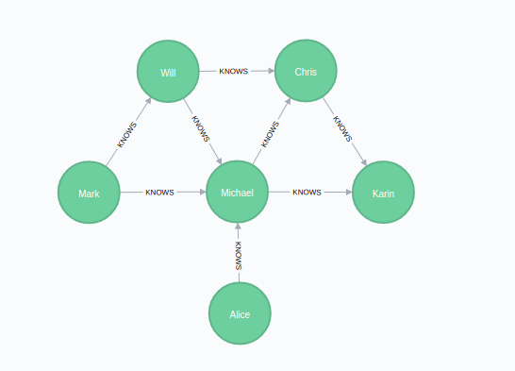
Triangle Count
Calculates the number of triangles for each node
A triangle is a set of 3 nodes, with all connected to each other
Popular in social network analysis, used to detect communities and measure the cohesiveness of those communities

Slide 31
Message passing
Can define custom logic to propagate information between nodes
For example, we can use this to aggregate the values of a specific feature from all neighbours.
Can chain these operations to allow propagation operate beyond 1 step

Slide 32
Motif Finding
Allows us to search for structural patterns in a graph using a Domain-Specific Language (DSL) for expressing queries.
Example:
graph.find("(a)-[e]->(b); (b)-[e2]->(a)")
A DataFrame matching the pattern is returned
Can negate the statement using “!”
Restrictions around what can be queries i.e. cannot just query negative edges but can query if an edge between x and y is missing assuming one between y and x exists.

Slide 33
Motif Finding
https://xebia.ai/a95

Slide 34
Exercise 4
Experiment with the different algorithms using the example graph data

Slide 35
Exercise 5 (Optional)
Brainstorm in groups how the aforementioned algorithms could be used for TMNL-specific use-cases

Slide 36
Citation Network Dataset
Dataset contains a list of research papers
Each paper is associated with abstract, authors, year, venue, and title
We have processed this data so that the nodes represent authors and the edges represent whether or not they have collaborated.
Data has been split into train and test (pre-2006 and post-2006)
Aim of the task is to predict whether or not a pair of authors will collaborate with each other.

Slide 37
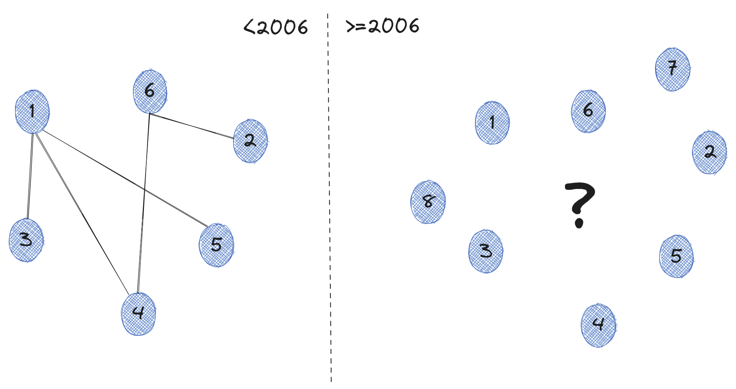
Citation Network Dataset

Slide 38
Citation Network Dataset
Graph representing training data contains sampled negative edges (implemented in PyTorch)
Positive pairs in training data will not appear as positive pairs in test data
If authors collaborated several times, the year of the earliest collab. is considered (subsequent removed)
Label to predict is coauth (1 if authors collaborated and 0 if they did not)

Slide 39
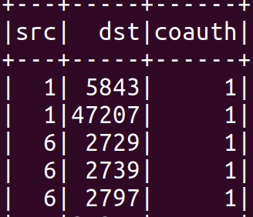
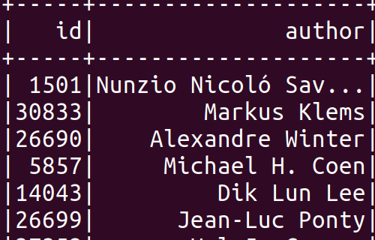
Training Graph Nodes and Edges:
Edges
Vertices

Slide 40
Citation Network Dataset
Tip: Using the following command, we can run the code using the dummy dataset, this is useful for developing to validate what our algorithms calculate for a smaller known graph:
$SPARK_SUBMIT src/train_model.py --use_dummy_data

Slide 41
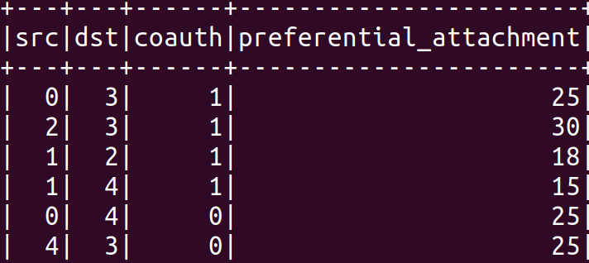
Exercise 6a
Implement the add_preferential_attachment() function inside features.py
preferential_attachment – produces a score for each pairs of authors by multiplying the number of coauthors each has. The intuition is that authors are more likely to collaborate with someone who has already coauthored a lot of papers.
Example output

Slide 42
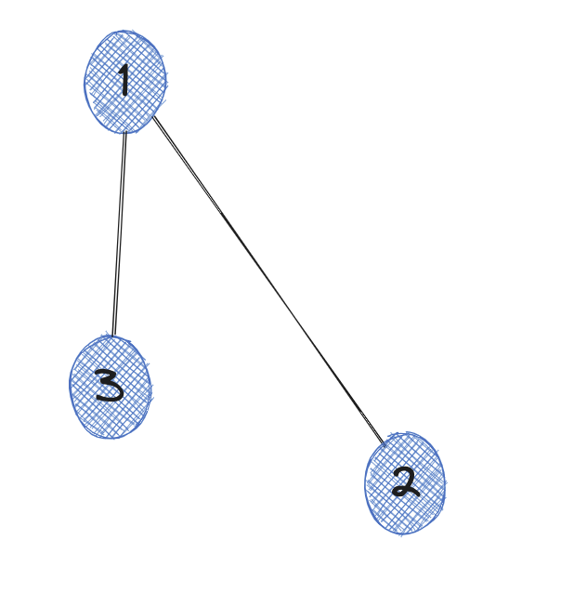
Exercise 6b
Implement the find_common_authors() function inside features.py
common_authors – the intuition here is that the more common/mutual authors a pair of authors have, the more likely they are to collaborate.
Here, 2 and 3 have one author in common

Slide 43
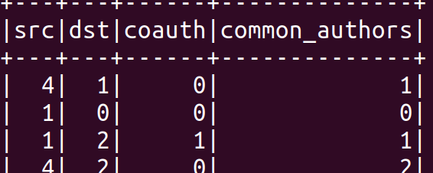
Exercise 6b
Tips:
We can use the motif finding functionality of GraphFrames to achieve this.
Our input graph only contains single edges (a>b but not b<a), this can be problematic when using motif finding
The presence of negative edges can also be problematic because they are only defined through the value of coauth. Think about how our motif finding will work in this case
Example output

Slide 44
Exercise 7 (Mini Hackathon)
Add more graph features that you think will be valuable to this predictive task.

